Slide 1
Navigating The Portability Rules
Estate Planning Council of Colorado Springs
May 10, 2016
Presented by
Jordon Rosen, CPA, AEP®
Director, Estate & Trust Section
Belfint, Lyons & Shuman CPAs
Wilmington, DE / West Chester, PA
jrosen@belfint.com/302.573.3911

Slide 2
About Jordon . . .
Jordon N. Rosen, CPA, MST, AEP® is a Director and shareholder in the Wilmington, Delaware CPA firm of Belfint, Lyons & Shuman, where he heads the firm’s estate and trust practice. Jordon also provides tax consulting and compliance services to the firm’s higher net worth clients and business owners. He is the Immediate Past President of the National Association of Estate Planners and Councils (NAEPC) and has served as president of the Delaware Estate Planning Council and the Chester County, PA Estate Planning Council. Mr. Rosen also serves as Chair of the Tax Committee of the Delaware State Chamber of Commerce, is a member of the AICPA Trust, Estate and Gift Technical Resource Panel and is a member of the editorial board of Thomson Reuters Focus publication.
Jordon is a licensed CPA in Delaware and Pennsylvania and is a member of the Pennsylvania Institute of CPAs, Delaware Society of CPAs and the AICPA Tax Section. He also holds the designation of Accredited Estate Planner ® and has been recognized the past 4 years as a 5-Star Wealth Manager by Philadelphia Magazine and Delaware Today.
Mr. Rosen is a frequently sought out speaker both locally and nationally on tax planning and related issues and has published more than 100 articles. He has been a frequent television and radio guest and a past host of Money Talk on 1450-WILM. He received his undergraduate degree in Accounting from Temple University and his Master’s degree in Taxation from Widener University.

Slide 3
Conventional Planning Prior to 2011
Tried to equalize estates
Didn’t always know who would die first
Some assets could not be re-titled
Re-titling in separate names could create creditor issues
Each spouse created identical wills/trusts
Creating a credit-shelter trust
Creating a marital trust

Slide 4
Conventional Planning Prior to 2011
At W’s death
Funded up to exclusion limit
CST
Children or grandchildren or trust
Income
HEMS
Estate of H
or
W
Marital Trusts

Slide 5
Conventional Planning Challenges
Not planning at all and wasting the first-to-die’s estate exclusion
Not being able to fully fund (balance) each spouse’s CST at the first death
Not requiring that the CST be funded or leaving the decision to the surviving spouse

Slide 6
With no Planning – Wasting the Estate Tax Exclusion Amount
 |  | H |  | W
Total Estate |  | $5,000,000 |  | $5,000,000
Marital Deduction at H’s Death |  | (5,000,000) |  | 5,000,000
H’s Taxable Estate |  | $-0- |  | 10,000,000
W’s Estate Exclusion at W’s Death |  |  |  | (5,000,000)
W’s Taxable Estate |  |  |  | $5,000,000

Slide 7
IRC Section 2010(c)(4)
Deceased Spousal Unused Exclusion (DSUE) amount
TRA 2010 – for decedents dying on or after 1/1/2011
Estate and gift tax exclusions were reunited at the hip (“use it now” or “use it later”)
“Portability” became permanent with the 2012 Tax Act
Final regulation became effective on June 12, 2015

Slide 8
Applicable Exclusion Amount
(Form 706, Line 9a) |  | Basic Exclusion Amount* ($5,430,000 in 2015)
(Form 706, Line 9b) | + | DSUE**
(Form 706, Line 9c) |  | AEA
* $5,000,000 in 2011 and indexed for inflation
** Not indexed for inflation – it is frozen at date of death

Slide 9
DSUE = Lesser of
The basic exclusion amount, or
The excess of
The applicable exclusion amount of the last such deceased spouse of such surviving spouse, over
The amount with respect to which the tentative tax is determined under Section 2001(b)(1) on the estate of such deceased spouse
IRC Section 2010 (c)(4)

Slide 10
 |  | H |  | W
Total Estate |  | $5,000,000 |  | $5,000,000
H’s prior taxable gifts and bequest to good friend Jordon Rosen |  | (3,000,000)
 |  | 2,000,000
Bequest to surviving spouse |  | (2,000,000)
H’s taxable estate |  | $ -0-
“Ported” to surviving spouse |  |  |  | 2,000,000
Surviving spouse’s BEA |  |  |  | $7,000,000*
*Available for future gifts/bequests

Slide 11
Generation Skipping Transfer Tax (GSTT)
No provision in law to “port” unused GST exemption

Slide 12
Making the Portability Election
Not an affirmative election. A deemed election is made if a timely and complete 706 is filed with DSUE and there is a surviving spouse
Election is made by the executor (Form 706, Part 6)
Not available to a non-resident surviving spouse who is not a U.S. citizen, except to the extent allowable by treaty with his or her country
Assets transferred to a QDOT – calculation is preliminary (Form 706, Part 6, Section B)

Slide 13
Making the Portability Election – Cont.
Election is effective as of date of death
Election is irrevocable as of the due date of Form 706
Uncertainty of exact amount of DSUE when filing the estate tax return where the election is (deemed) made, does not negate the election; only the amount of the DSUE will change.
SOL is extended with regard to the determination of the DSUE amount until the expiration of the SOL of the surviving spouse’s estate.

Slide 14
Requirements of Return When Making Election
Complete and properly prepared in accordance with instructions and regulations
Reporting values on Form 706 that is not otherwise required to be filed
Property subject to marital or charitable deduction– only need to report
Description
Ownership
Beneficiary
Information to establish right of estate to the deduction

Slide 15
Requirements of Return When Making Election – Cont.
Rule does not apply to property if
Value needed to determine value passing to another recipient
Value needed to determine eligibility under Section 2032 (alternate valuation), 2032A (farm valuation), or Section 6166 (extension of time to pay tax)
Less than the entire interest in the property is marital or charitable deduction property
A partial disclaimer or partial QTIP election is made with respect to property which is marital or charitable deduction property

Slide 16
Statement Required on Form 706
If executor exercises due diligence to estimate FMV of the gross estate
Executor (under current regulations) can include his/her best estimate rounded to the nearest $250,000
Signed under penalties of perjury
Will be considered a complete and properly filed return
Regulation Section 20.2010-2T(a)(7)

Slide 17
Who is Permitted to Make (or opt-out-of) the Election?
Duly appointed executor or administrator of the estate
If no duly appointed executor – a non-duly appointed executor in actual or constructive possession of any property of the decedent
Portability election made by a non-appointed executor cannot be superseded by a contrary election by another non-appointed executor of the same estate
What if executor and surviving spouse do not agree?

Slide 18
Rev. Proc. 2014-18 – Deadline for portability for small estates of pre-2014 decedents:
Allowed small estates of pre-2014 decedents where a Federal estate tax return was not otherwise required to be filed, to make a late portability election if the estate return was filed by December 31, 2014

Slide 19
Late Elections
No relief if estate was otherwise required to file Form 706
If filing just to elect portability
Section 9100 relief may be available.
Treasury hesitating to make this relief permanent for fear of executors not making the election until after the surviving spouse’s death

Slide 20
Opting Out of Portability
✓ the box – Form 706, Part 6, Section A
Small estates that otherwise do not have to file Form 706, simply do not file anything
If a return is otherwise required to be filed, the filing of a late Form 706 is considered opting-out of the portability election (Prop. Reg. Section 20.2010-2(a)(3)(ii))
Hazards of not electing portability
Assets grow
Some people actually win the lottery

Slide 21
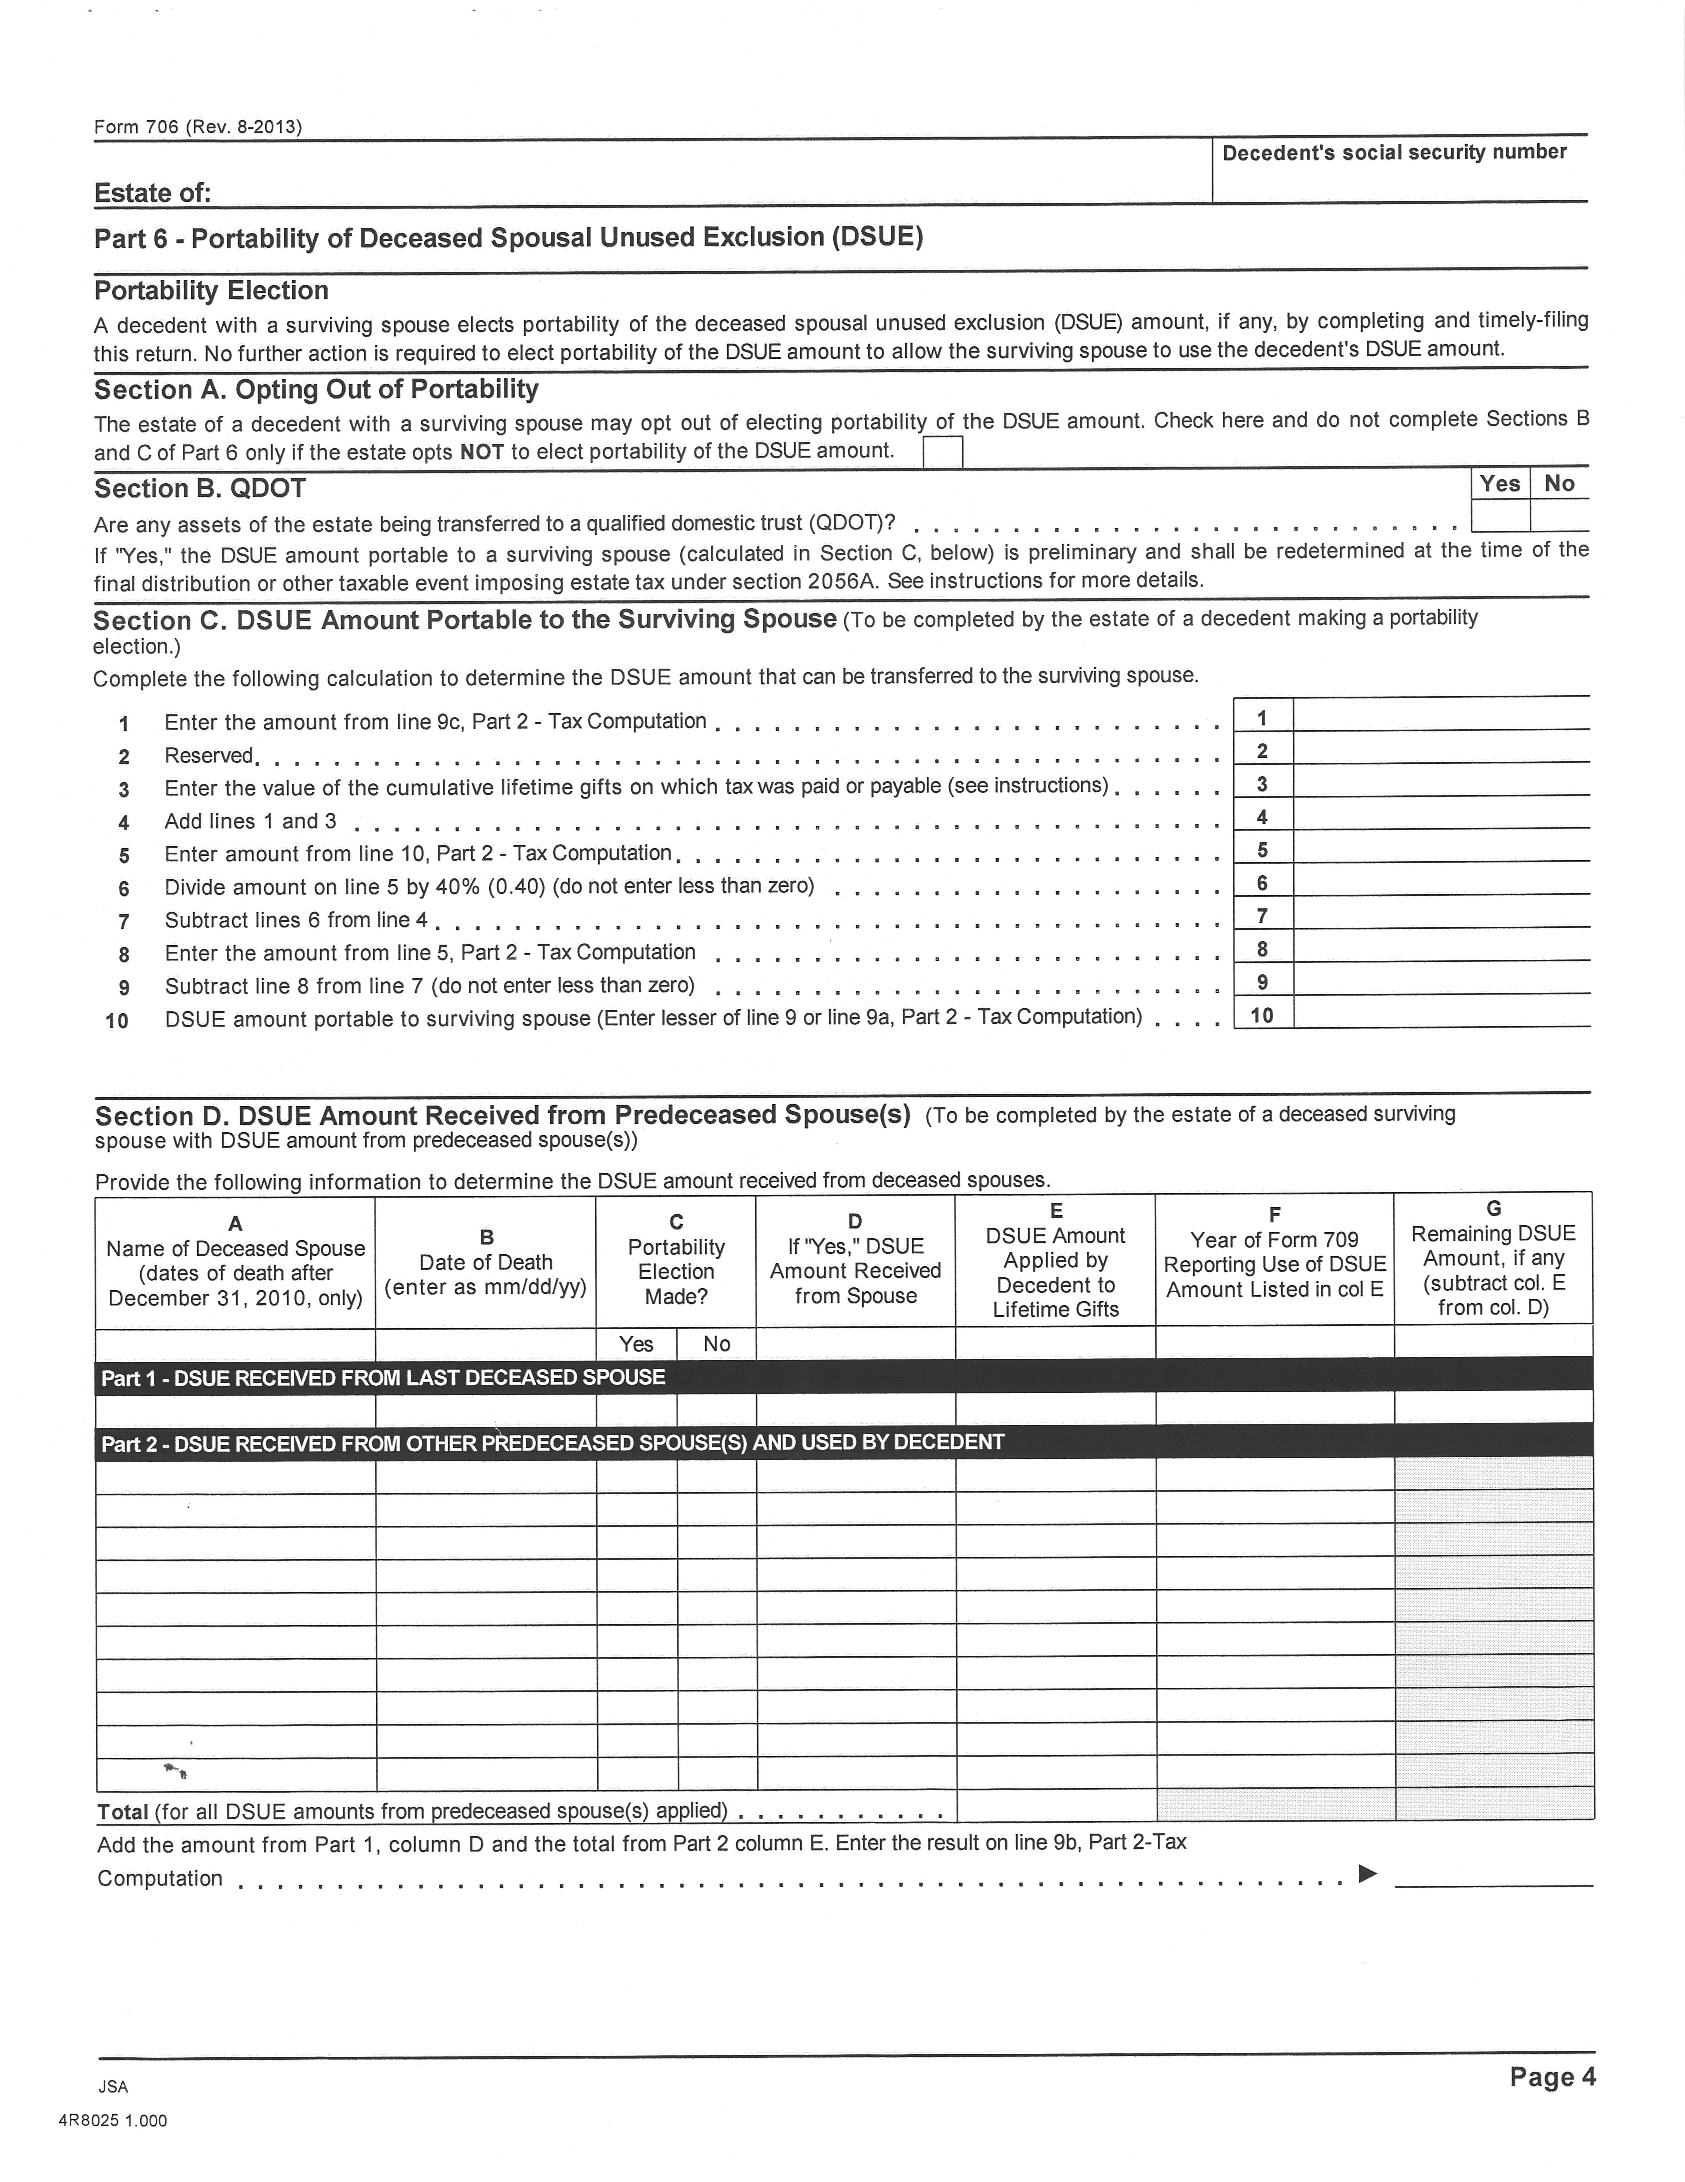

Slide 22
Last Deceased Spouse
Most recently deceased person who was married to the surviving spouse at the time of that person’s death
Identity as of day of taxable gift or the date of the surviving spouse’s death
Re-marriage does not alter the designation of last deceased spouse. Surviving spouse can apply DSUE amount to future lifetime gifts
Apply DSUE first; then own BEA
Multiple DSUE amounts

Slide 23
How Smaller Estates Will Be Affected By
Basis Consistency Rules
New Form 8971 Reporting Rules

Slide 24
DSUE v. CST
or
Income Tax v. Estate Tax

Slide 25
Advantages of CST
Asset protection (generally not available using DSUE)
Appreciation exempt from surviving spouse’s estate (but no step-up)
GST protection

Slide 26
Advantages of DSUE Election
Get a second basis step-up at surviving spouse’s death
Ultimate Federal and state capital gains tax savings
Lower administrative expenses
Allows for spousal rollover of IRA/retirement plan assets
Allows for stretch IRA for non-spousal beneficiaries
Control/GPA (limited for retirement plan assets)
Income subject to individual tax brackets, not condensed trust brackets
Could save/avoid NII tax for same reason
Get a second basis step-up at surviving spouse’s death
Ultimate Federal and state capital gains tax savings
Lower administrative expenses
Allows for spousal rollover of IRA/retirement plan assets
Allows for stretch IRA for non-spousal beneficiaries
Control/GPA (limited for retirement plan assets)
Income subject to individual tax brackets, not condensed trust brackets
Could save/avoid NII tax for same reason

Slide 27
Using a QTIP Trust
No estate tax inclusion at first death
Included in surviving spouse’s taxable estate
Assets get a second step-up
Control-keeps assets in family
General asset protection
Can get GST protection with a reverse QTIP election
T.D. 9725 – Treasury and IRS intend to provide guidance . . .
Whether a QTIP election made under Section 2056(b)(7) may be disregarded and treated as null and void when an executor has elected portability of the DSUE amount under Section 2010(c)(5)(A). Also, see Rev. Proc. 2001-38.

Slide 28
Community Property
Each spouse owns half the property
DSUE is not as much of an issue

Slide 29
State Death Taxes
DSUE (portability) is a federal concept
States have not yet adopted portability election statutes
May need to be creative in states where estate exclusion is less than the Federal amount
NJ - $675,000
MD - $1,500,000 in 2015 (will match federal amount by 2019)
PA - $0
Use of CST to protect assets up to state exclusion
Use of Marital Trust followed by gift to children’s trust by surviving spouse (could have limited benefits in states such as CT and PA)

Slide 30
Qualified Domestic Trust (QDOT)
Allows for marital deduction for bequeathed property passing to a surviving spouse who is not a U.S. Citizen
Estate tax is generally imposed under Section 2056A when distributions are made from the trust
If DSUE amount
Executor determines a preliminary DSUE amount
Decreases as Section 2056A distributions are made
Not available to the surviving spouse against tax on lifetime gifts since final determination of DSUE is postponed until death of surviving spouse or termination of QDOT

Slide 31
Questions?

